Slide 1




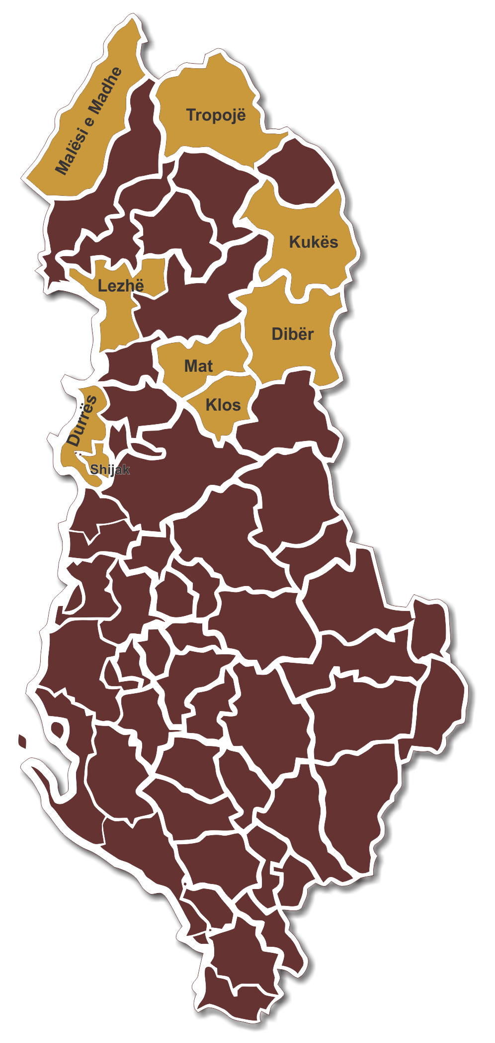

Functional Areas Programme
Valbona Karakaçi
(dldp/HSI)

Slide 2

Functional Areas Programme
The Functional Area Programme (FAP) started from the Functional Areas research in the five regions of dldp 3 focus.
The FA research identified and measured several interaction variables (economic, social, administrative, leisure etc.) amongst communities across administrative borders.
The FA research identified the FA potential borders and respective options in the five regions.
The FA remains a criteria investigating development potential beyond borders, following up dynamics at any level they take place
Programme for Decentralization and Local Development (dldp) | www.dldp.al | www.km.dldp.al | dldp@helvetas.org

Slide 3
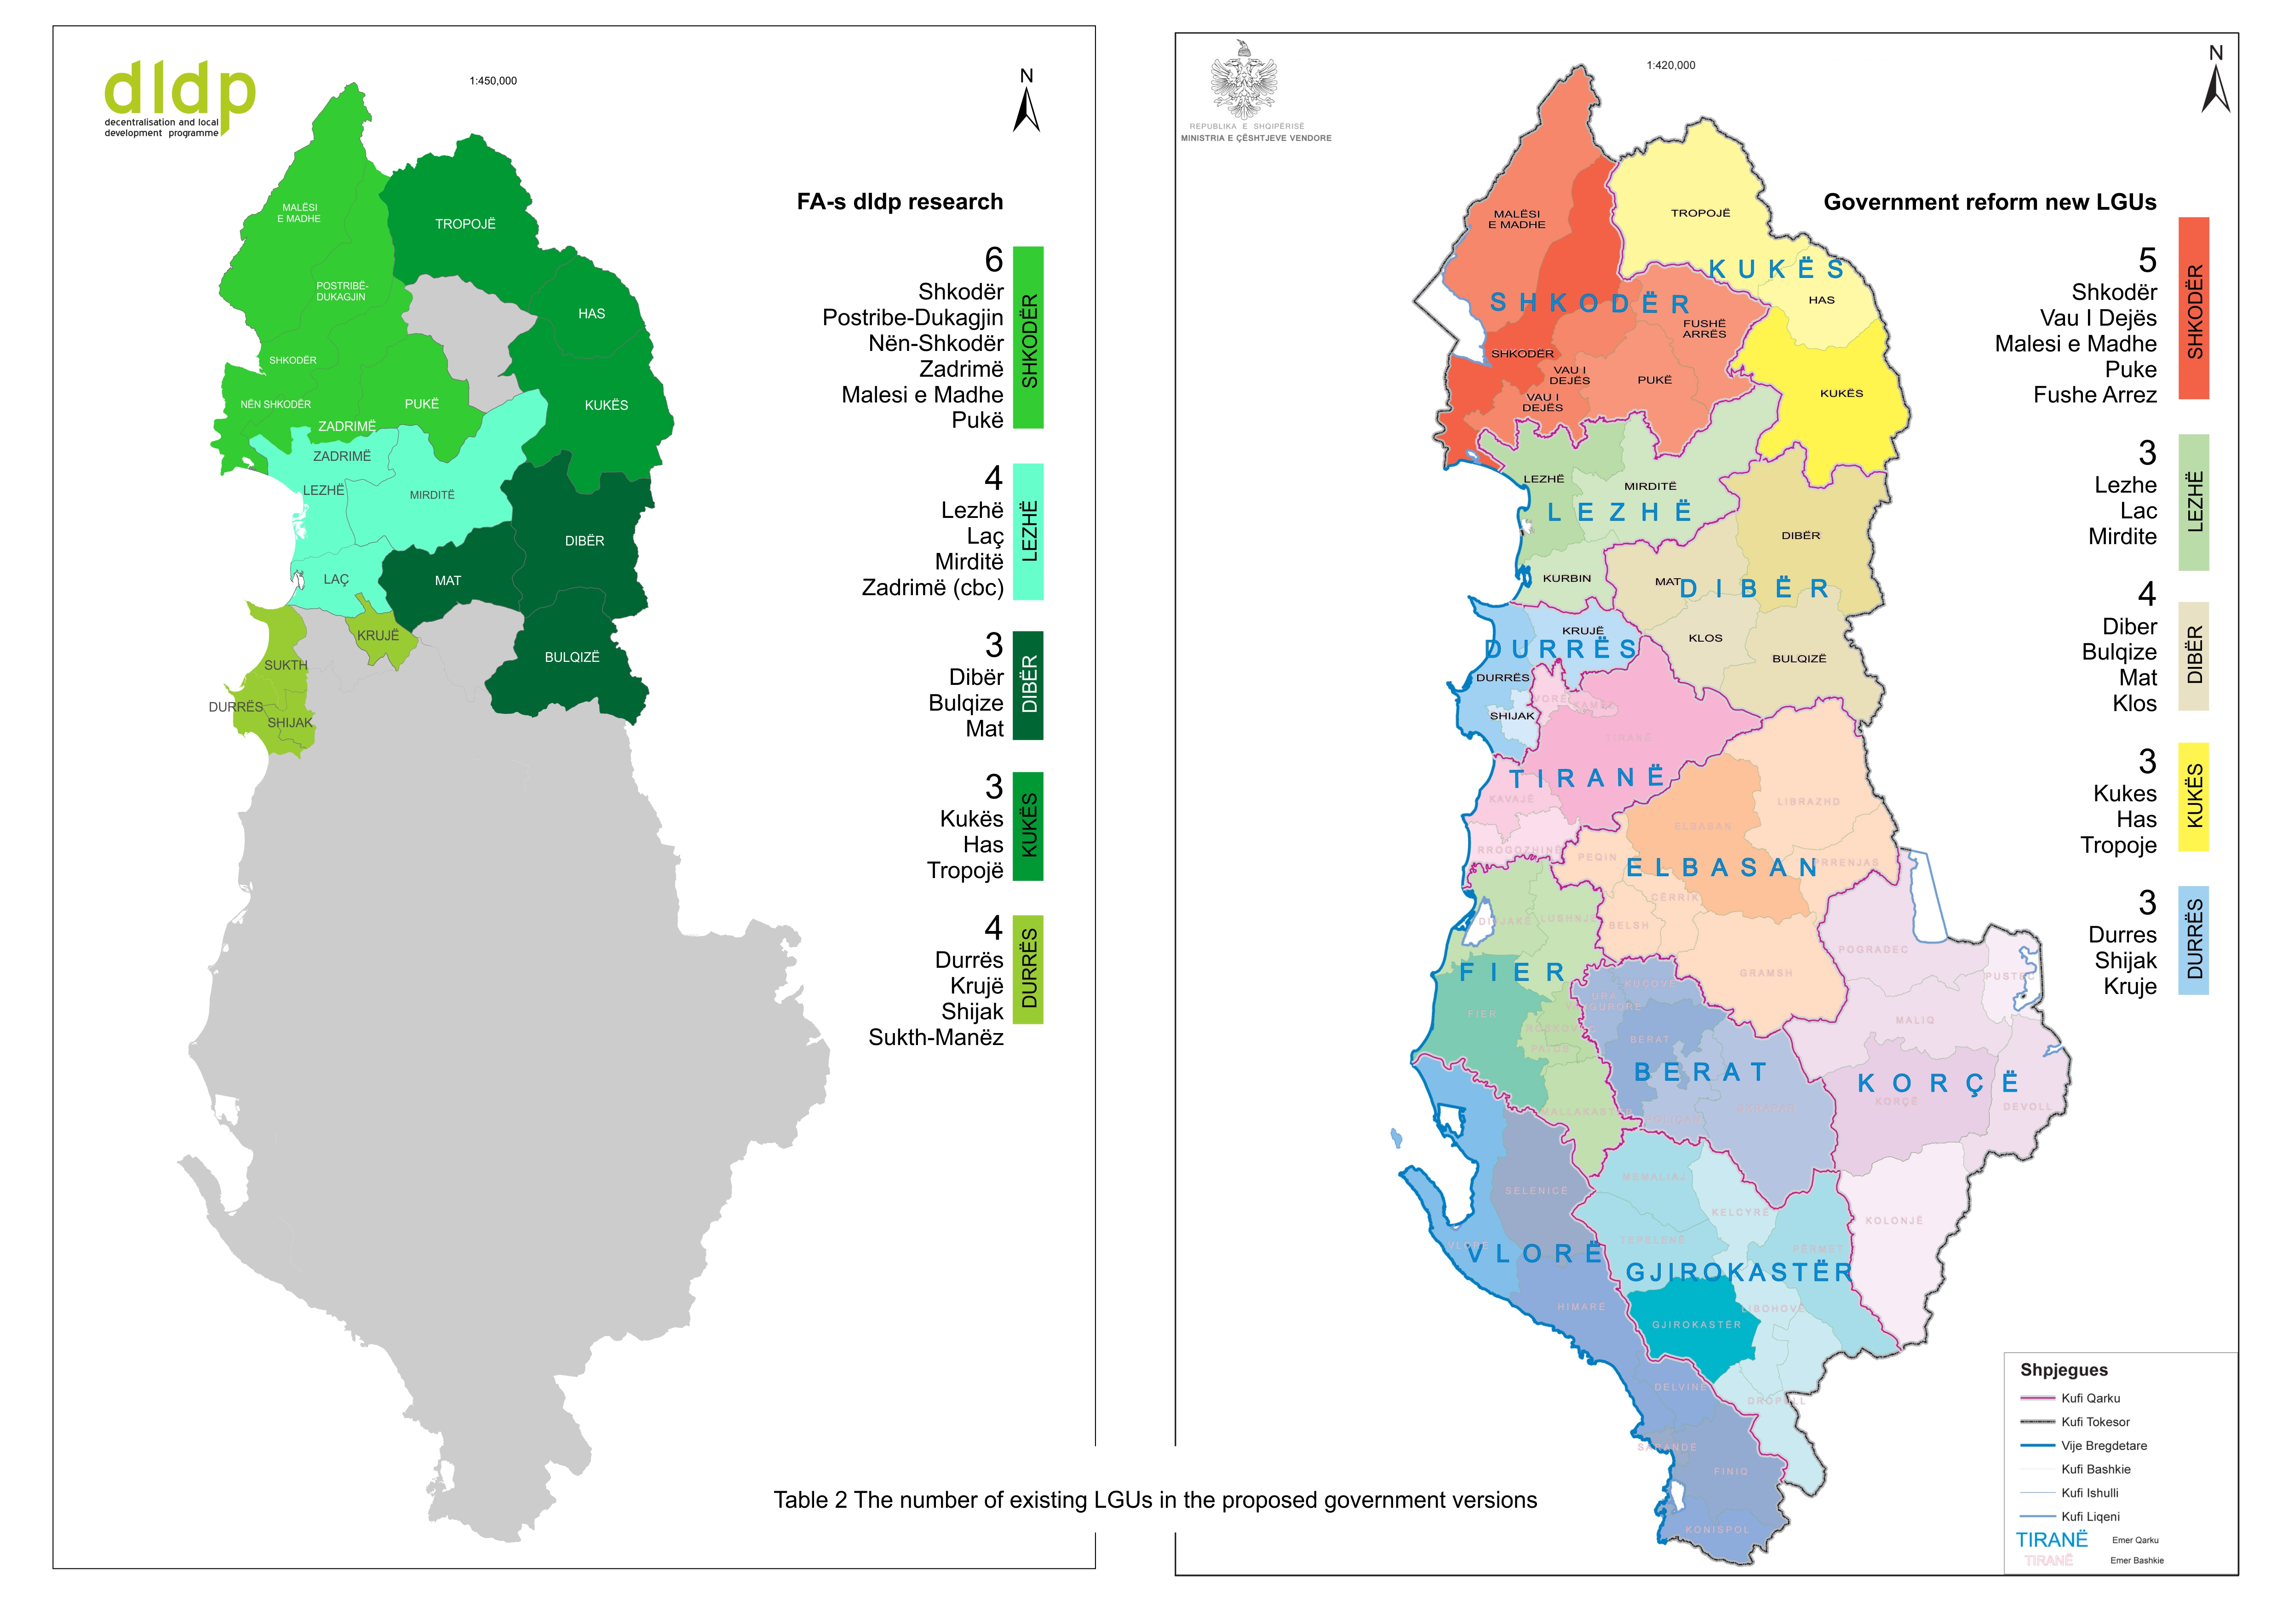
FUNCTIONALITY AS A DEVELOPMENT CRITERIA

Slide 4
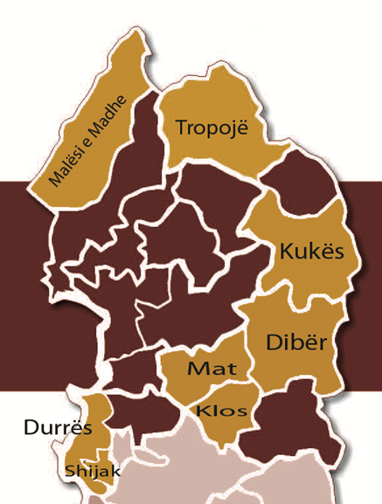
Functional Areas Programme
  Based on these findings dldp 3 started piloting of the Functional Area Programmes (FAP-s) in five regions of (30 % of population)
By understanding of the interaction dynamics through in depth analyses in a given FA, FAP serves as a basis to identify a group of projects that will facilitate-initiate-intensify these interactions.
Programme for Decentralization and Local Development (dldp) | www.dldp.al | www.km.dldp.al | dldp@helvetas.org

Slide 5

What is expected from the FAP output/product ready for national replication
Guiding document
Scenarios of development for eight FAs
Scenarios for service delivery for eight FAs
Bundle of priority projects per each LGU
Selected recommendations on org.dev.
METHODOLOGY

Slide 6

LGU-s as contributors and beneficiaries
At local level:
During October 2014- April 2015 , dldp worked intensively for the preparation of eight FAP-s: Malësi e Madhe, Lezhë, Durrës, Shijak, Kukës, Tropojë, Dibër and Mat (Klos).
Nine LGUs will have an important document to delineate the development prospects as well as a group of important projects identified.
The best FAP for two typologies are evaluated from a multi stakeholder jury (16 members, 50% development programmes and 50% ministries and national agencies).
The FAP will be re legitimized with the new LGU-s after elections and selected projects will be funded through a grant system.
Programme for Decentralization and Local Development (dldp) | www.dldp.al | www.km.dldp.al | dldp@helvetas.org

Slide 7
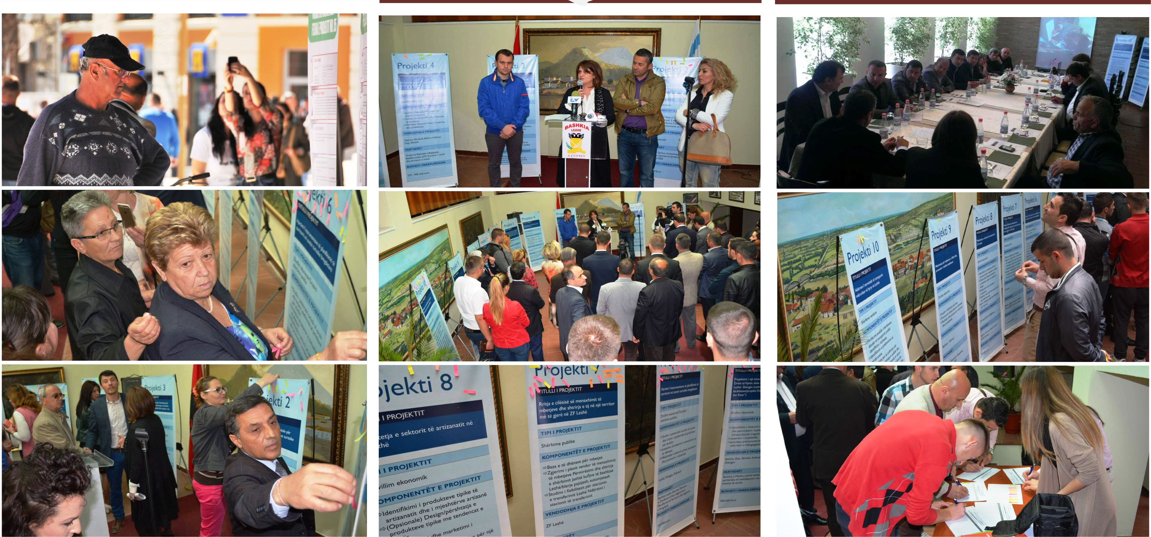
FAP and public participation
The FAP preparation process combines a robust technical expertise component with the public participation.
Public participation is ensured through:
a) The FAP forum including the representatives of different interest groups (34 forums with 750 participants)
b) The public at large in the FA-s is reached through an intensive communication interactive campaign (outreach of 830 persons)
Programme for Decentralization and Local Development (dldp) | www.dldp.al | www.km.dldp.al | dldp@helvetas.org

Slide 8
Project identification and ranking (105 projects)
  Public evaluation = ranking of
  projects in each FA
  Technical evaluation = 10 cri-
  teria (e.g. impact, maturity,
  cohesion…)
  Consolidation of all info in an
  analytical data base
  Short list of the top 3 rated
  projects per FA
Public evaluation (50%)
Citizens
(25%)
Businesses
(12%)
Technical jury (50%)
Qark
(1)
Prefecture
(1)
Local elected
(13%)
Core municipalities
(3)
.
.
Programme for Decentralization and Local Development (dldp) | www.dldp.al | www.km.dldp.al | dldp@helvetas.org

Slide 9
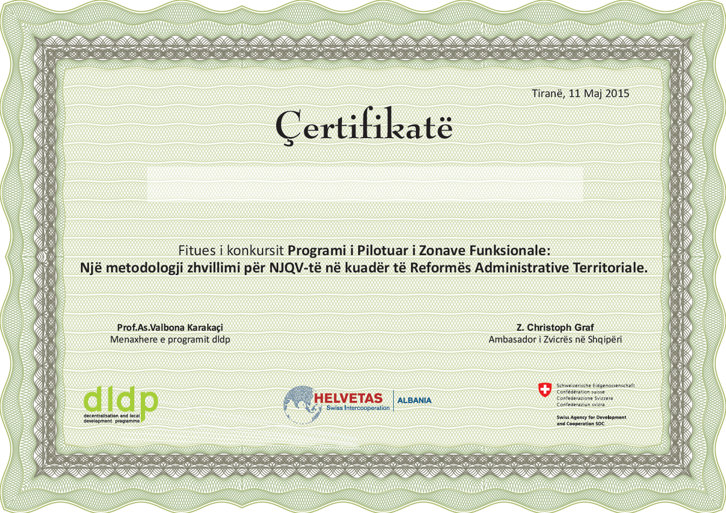
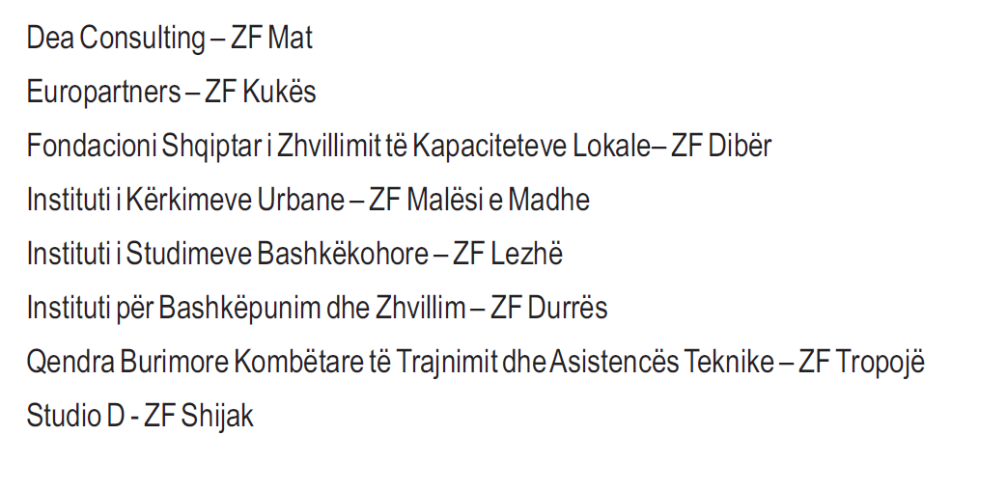
Functional Areas Programme
For the implementation of the pilot, Dldp cooperated with eight organizations (service providers) that created a valuable experience and contributed in FAP methodology.
Programme for Decentralization and Local Development (dldp) | www.dldp.al | www.km.dldp.al | dldp@helvetas.org

